Slide 1
CS188 Project Khoa Nguyen

Slide 2
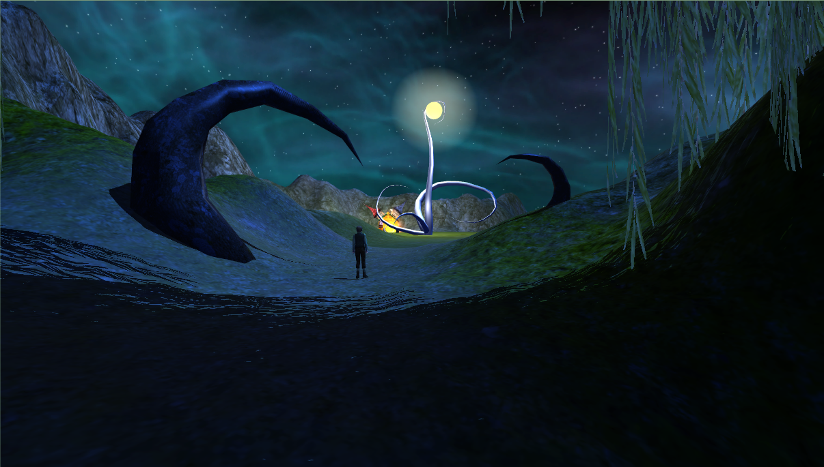
Moonflower
Based on “The Moon,” a Grimm’s fairy tale.
Story: A boy found the moon before it was ready to light up the world.

Slide 3
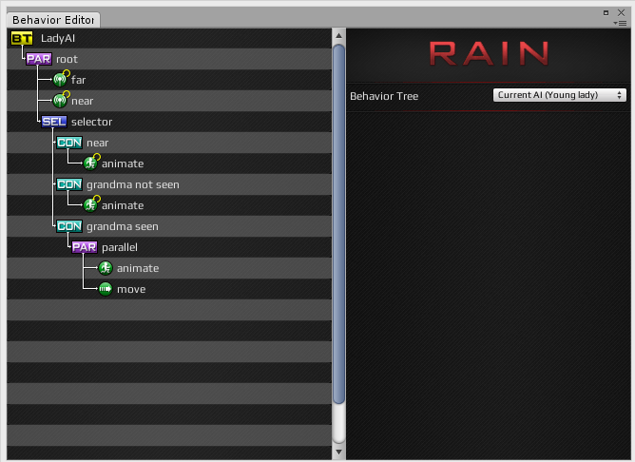
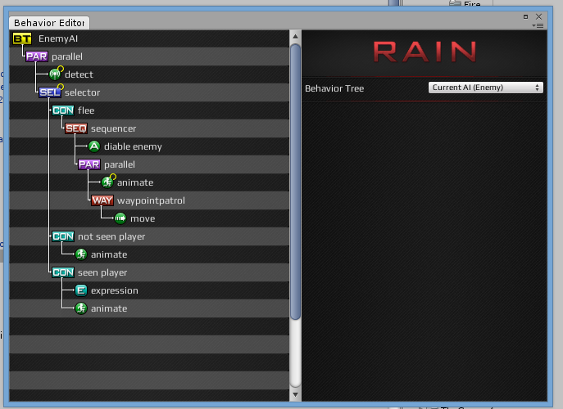
RAIN AI

Slide 4
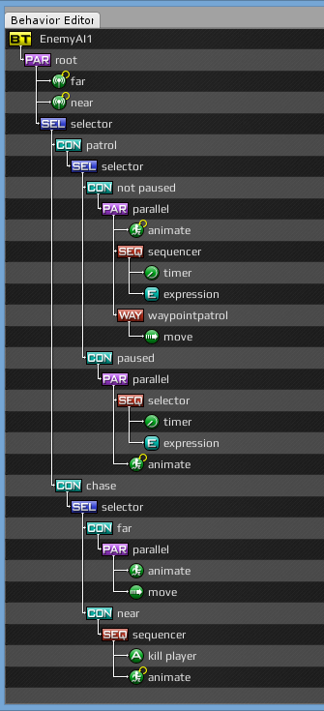
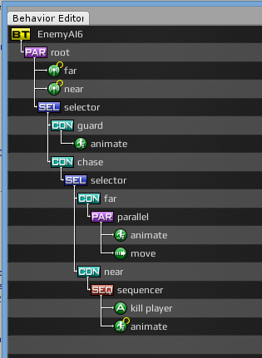
RAIN AI

Slide 5
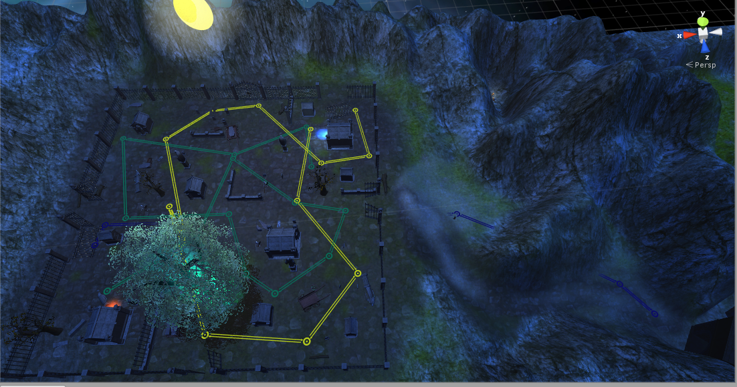
RAIN AI

Slide 6
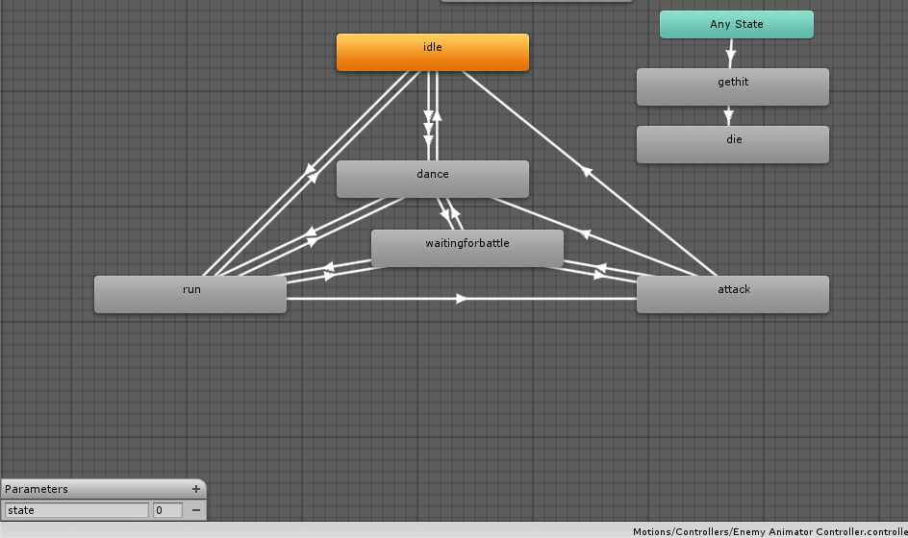
Animator
Enemies

Slide 7
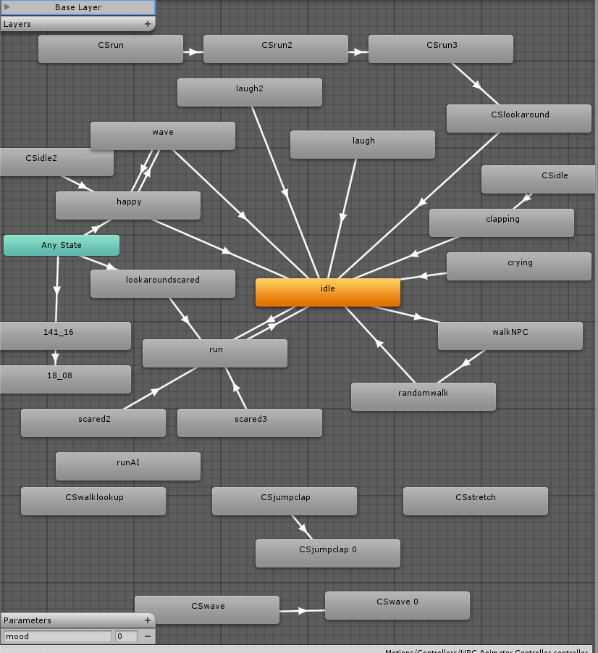
Animator
Villagers

Slide 8
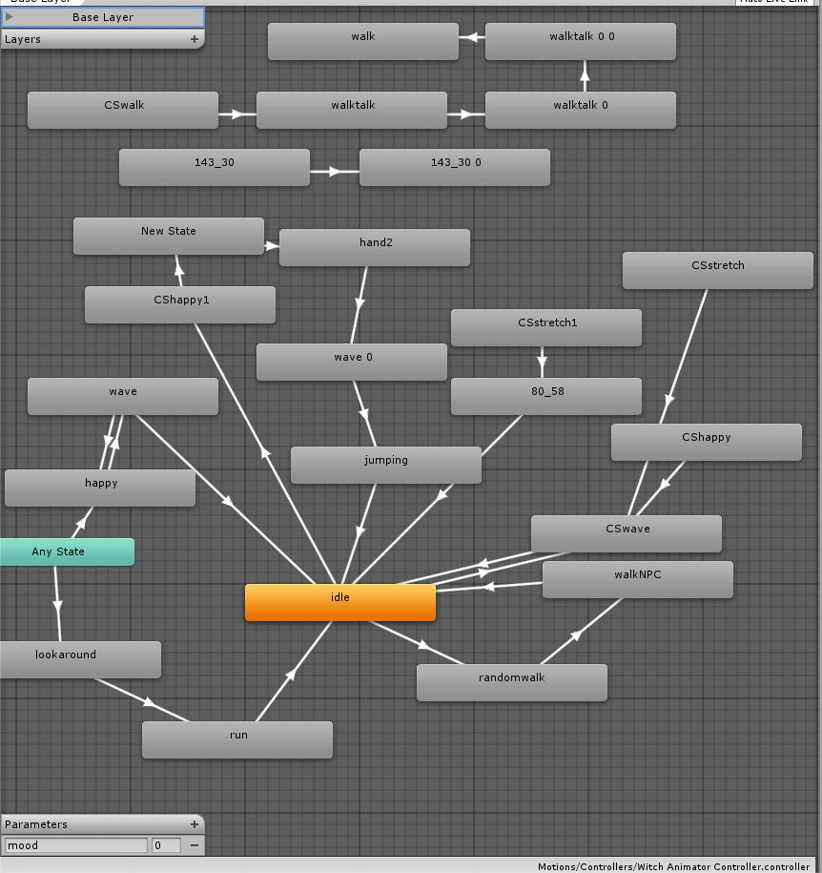
Animator
Witch

Slide 9
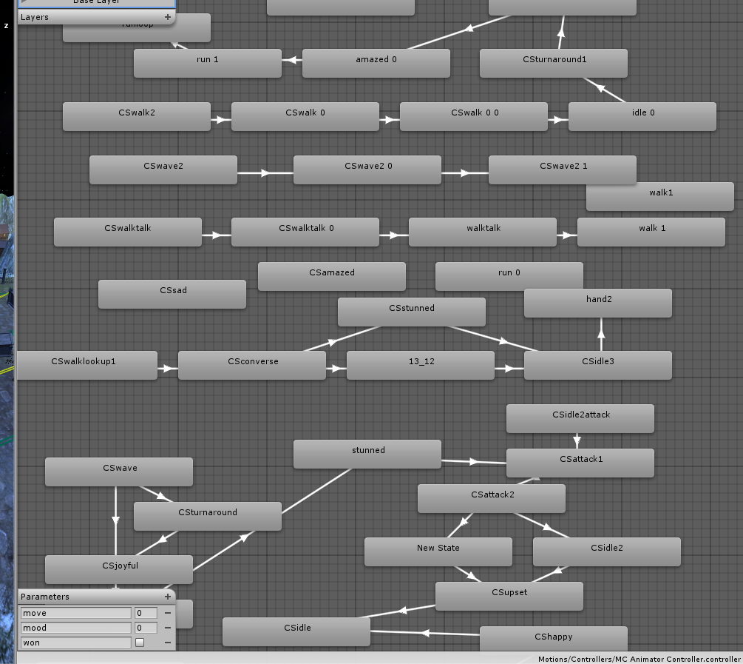
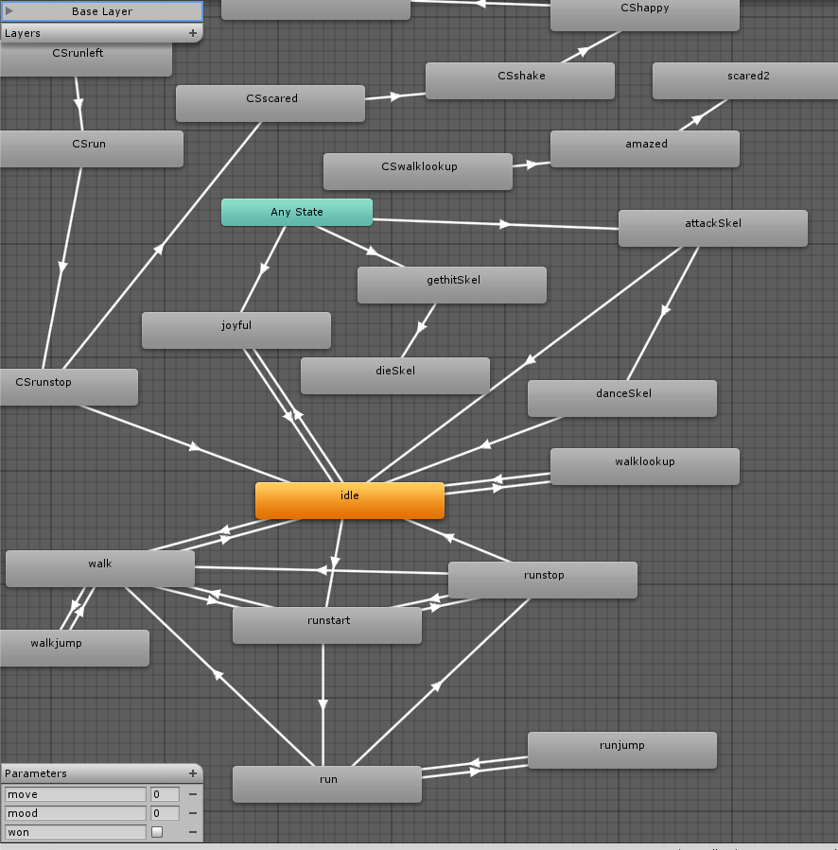
Animator
Little boy

Slide 10
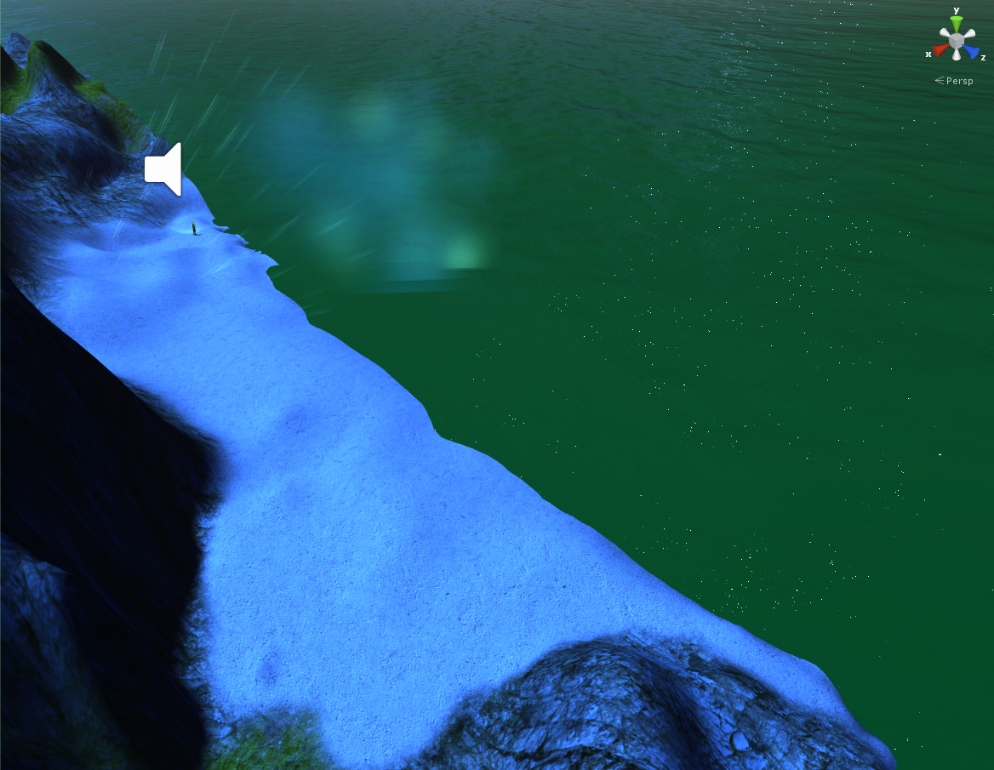
Misc.
GUI
BGM
Particle systems

Slide 11
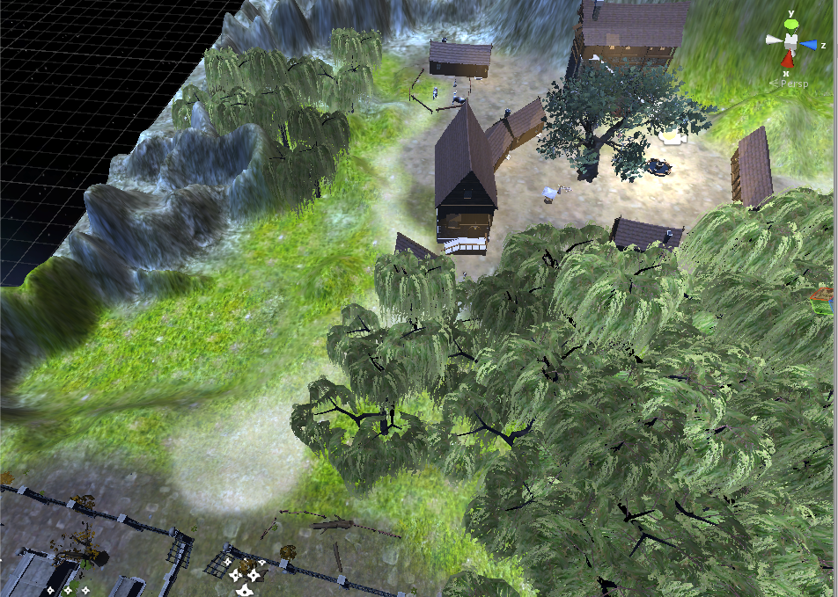
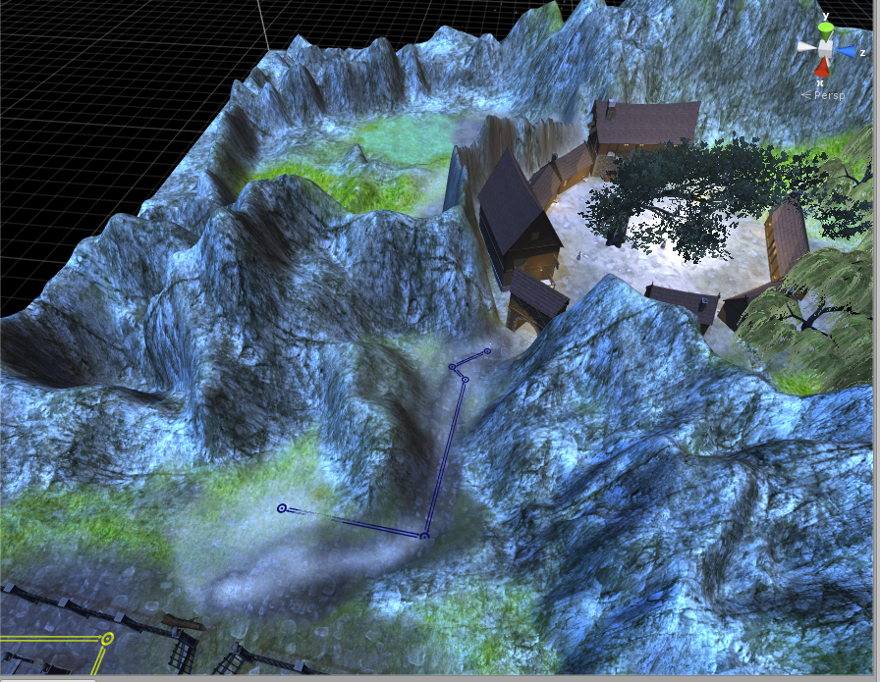
Optimization

Slide 12
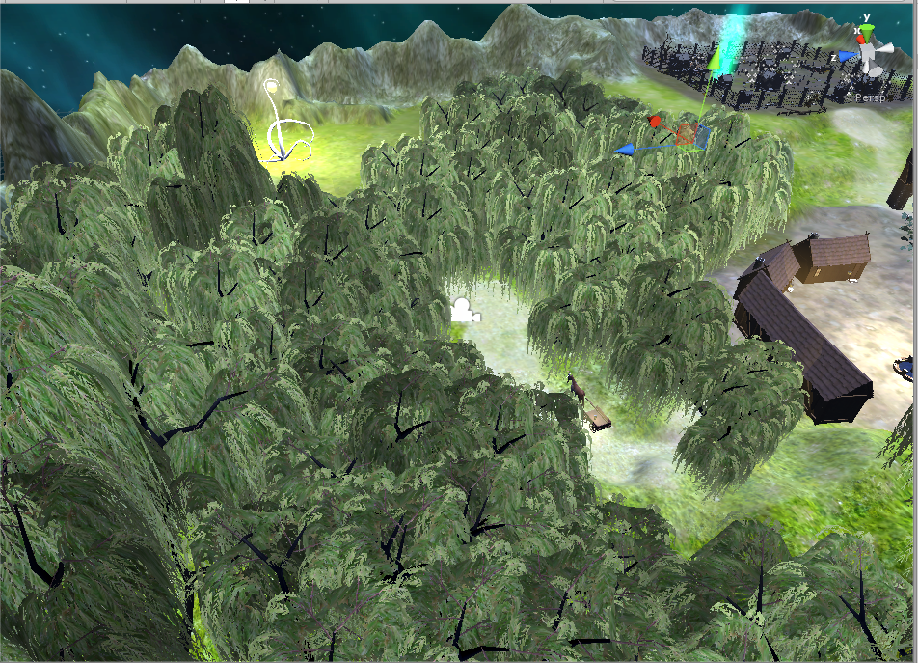
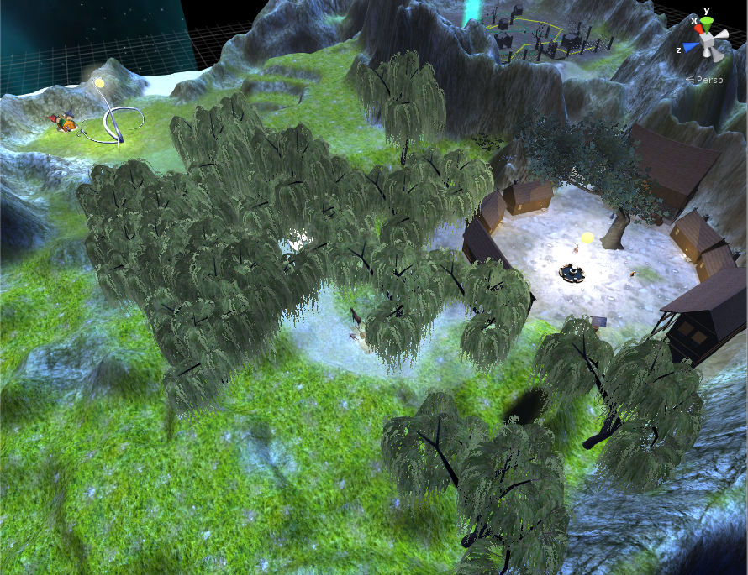
Optimization

Slide 13
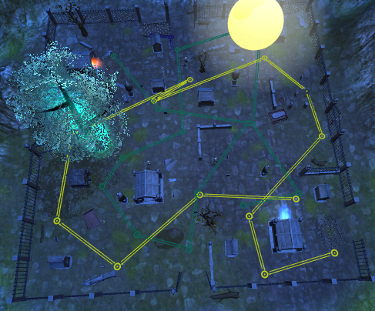
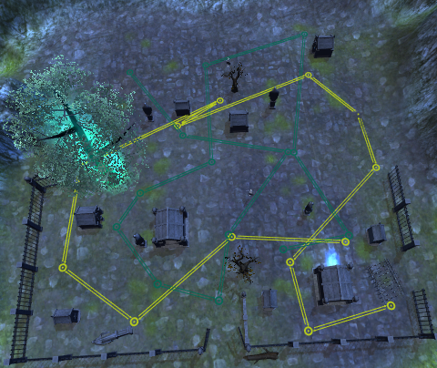
Optimization

Slide 14
Optimization
Less lightings
No grass, flowers or animals
Less trees
No tree colliders
Free roaming to boxed level
Downgrade model quality
Disable models and scripts while not in view
Lower camera distance
Remove mesh colliders, combine into big box colliders

Slide 15
Issues
Framerates
Unity crashing
Music not looping seamlessly yet
Game not fun

Slide 16
Conclusion
Thank you for listening!
Khoa Nguyen
Winter 2015

